Slide 1
CCC RLOGIC BIOS version non-complaint with Agile ---- 5C report
June.01.2019

Slide 2

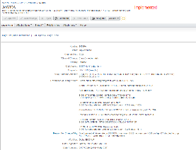
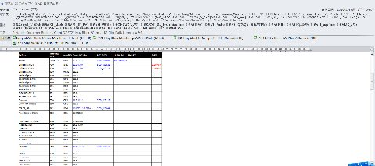

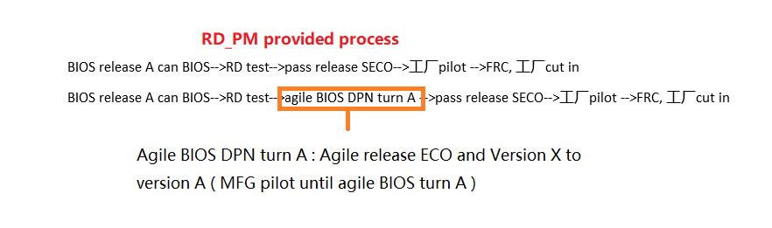
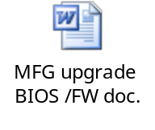
CCC RLG BIOS version non-complaint with Agile
CHARACTERIZE | Issue #:20200605 | Issue Title: Shanghai FW Version non-compliant with Agile
 | Open Date: 2020/06/05 | Description: On Jun 1st DELL highlight Shanghai FW version non-compliant with Agile for M05
 | ODM member: RMA QA: Gao_GavinG / Zhang_Jianying SH Rlogic QA : Ji_Xiaojuan
Containment | Containment actions : Shanghai: sorting North Bay 14 TS/NT 4pcs ,and confirm FW version: A09 (1.6.5) compliant Agile Owner: Ji. Xiaojuan Done: 6/2
CAUSE | Root cause: 1: This model is MP statue, so we follow block notice to cut in FW version ,and block notice released 7 days later than Agile completed date. And fixed within 7 days all of the TPR need upgrade version in their process after block notice released .attachment BIOS/FW cut in process flow chart Agile release A09 date: 4/27 Block notice A09 date: 5/4 2: Confirmed with RD team , MP cut in FW process match agile release process , found all of the most block notice will delay.

Slide 3
CCC RLG BIOS version non-complaint with Agile
Correct action | Corrective action: NA
 | Preventive action: We will update the BIOS version information on the TPR management system on time. The TPR management system will check the BIOS version information in the TPR upload test log after 7 days , If the BIOS version is different, an error will be reported. Owner: JQE . Done: 2019/6
CLOSURE | Verification: Continues tracking Approved by: Cemon Liu

